Slide 1
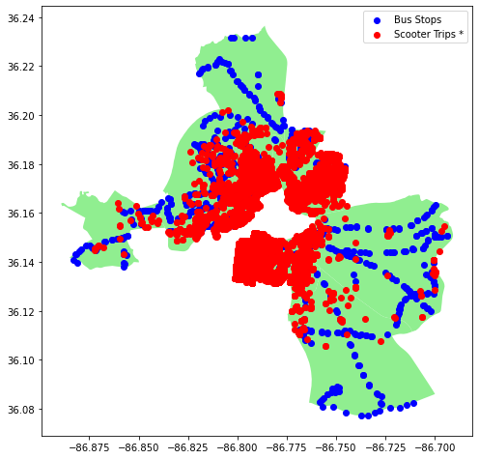
May Scooter Trips and Bus Stops in Promise Zone
* By trip start location

Slide 2
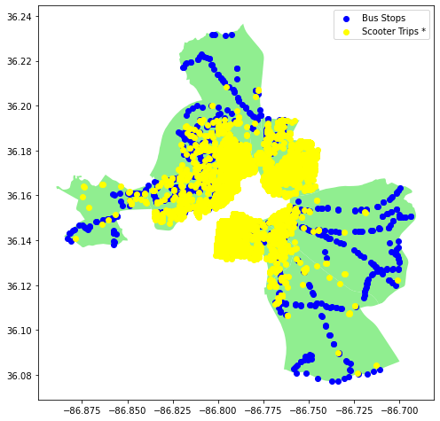
June Scooter Trips and Bus Stops in Promise Zone
* By trip start location

Slide 3
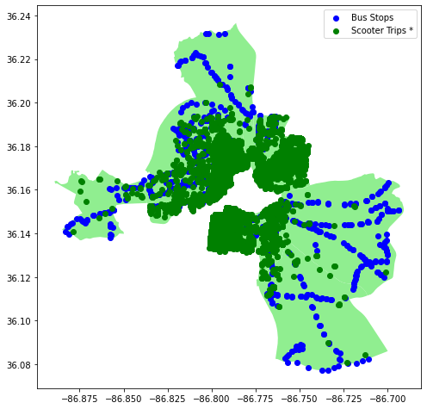
July Scooter Trips and Bus Stops in Promise Zone
* By trip start location

